Slide 1
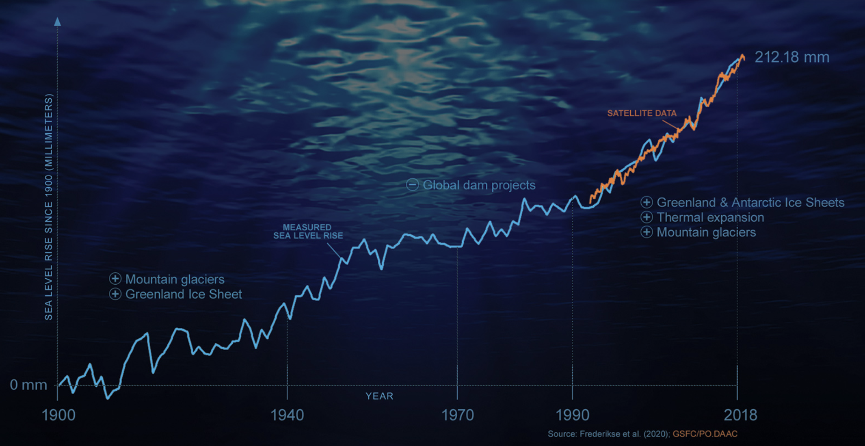
Thermodynamics and global sea level rise
https://climate.nasa.gov/news/3012/nasa-led-study-reveals-the-causes-of-sea-level-rise-since-1900/
What does thermodynamics have to say about this?

Slide 2
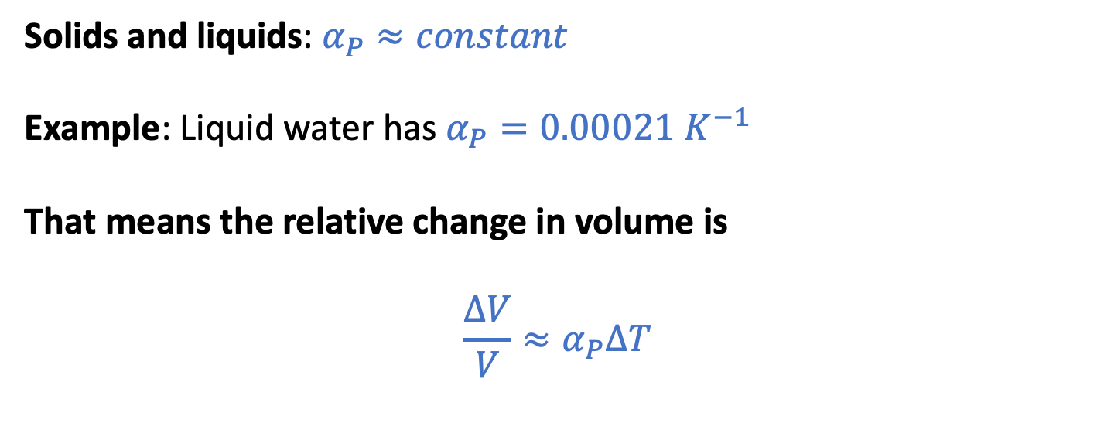


The isobaric thermal expansivity (focusing on the oceans)
$$α_{P}≡\frac{1}{V}{\left(\frac{∂V}{∂T}\right)}_{P}$$
$$∆V$$
Solids and liquids: $α_{P}≈constant$
Example: Liquid water has $α_{P}=0.00021{ K}^{−1}$
That means the relative change in volume is
$${\frac{∆V}{V}≈α}_{P}∆T$$
$$V$$

Slide 3



The isobaric thermal expansivity (focusing on the oceans)
$$α_{P}≡\frac{1}{V}{\left(\frac{∂V}{∂T}\right)}_{P}$$
For a given column of water, this means
$${\frac{∆h}{h}≈α}_{P}∆T$$
or
$$∆h {≈h α}_{P}∆T$$
$$∆h$$
$$h$$

Slide 4
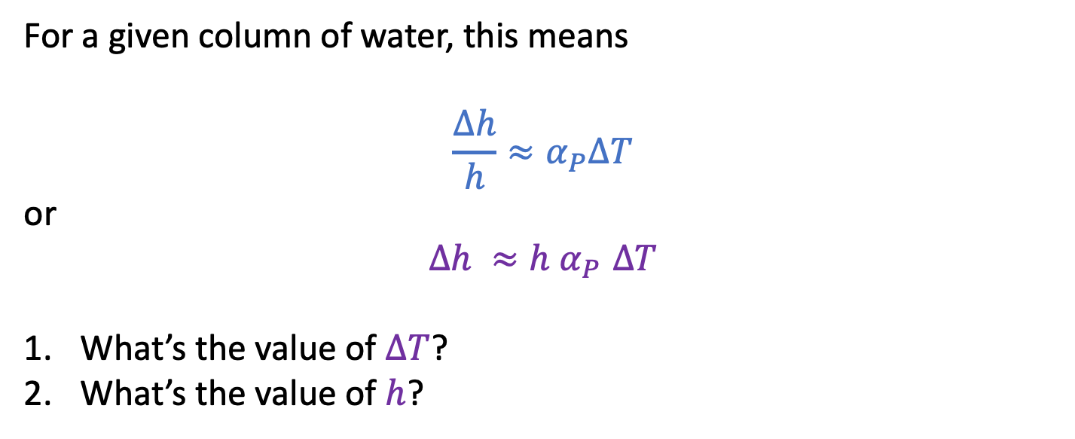
The isobaric thermal expansivity (focusing on the oceans)
$$α_{P}≡\frac{1}{V}{\left(\frac{∂V}{∂T}\right)}_{P}$$
For a given column of water, this means
$${\frac{∆h}{h}≈α}_{P}∆T$$
or
$$∆h {≈h α}_{P}∆T$$
What’s the value of $∆T$?
What’s the value of $h$?
$$∆h$$
$$h$$

Slide 5
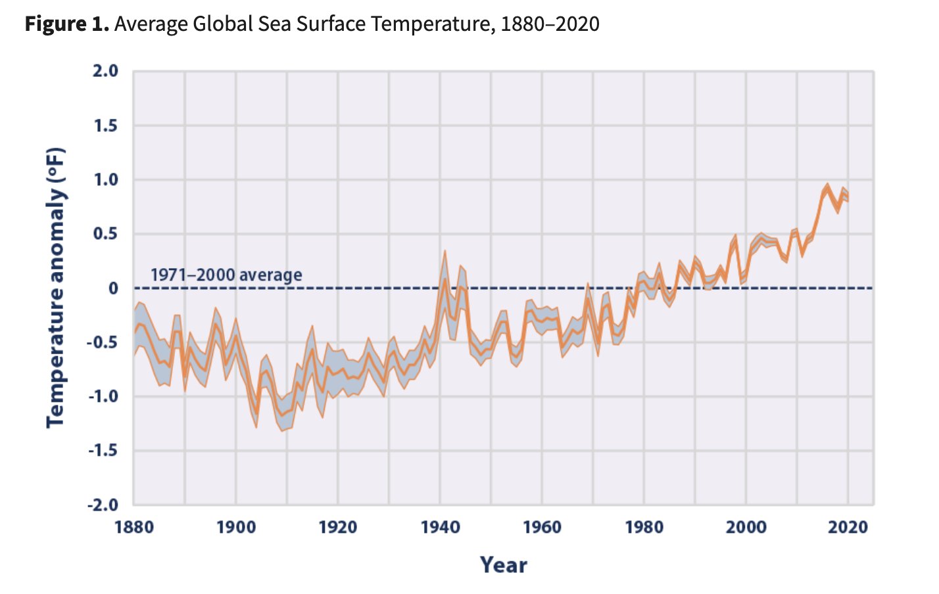

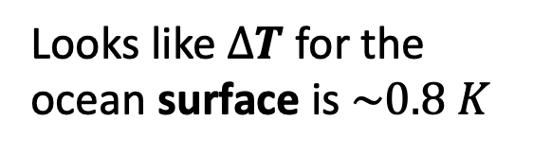
Global sea surface temperature, 1880-2020
$$∆T= 1.5 ℉= 0.8 K$$
Looks like $∆T$ for the ocean surface is $\sim 0.8 K$
https://www.epa.gov/climate-indicators/climate-change-indicators-sea-surface-temperature

Slide 6
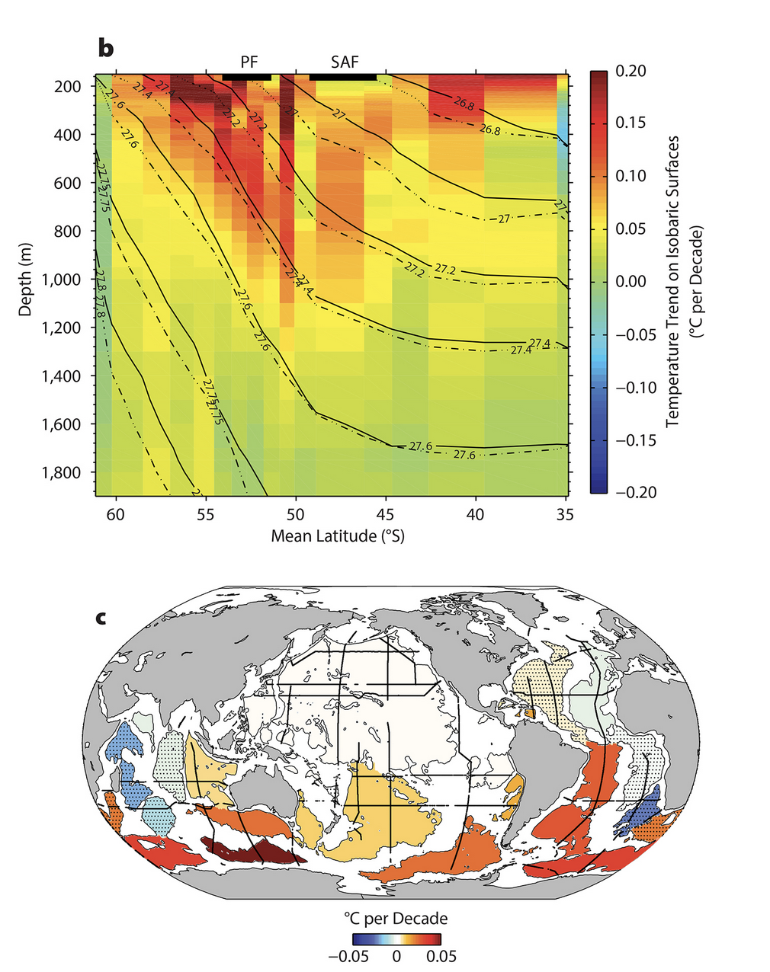
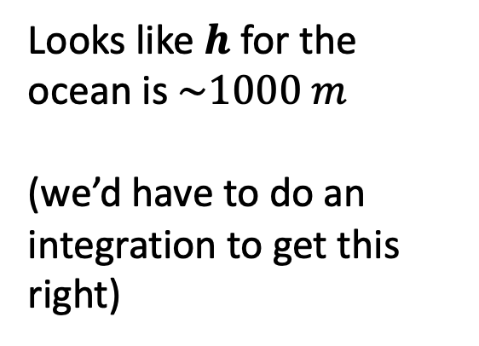
Depth of the warming (Southern Ocean)
Looks like $h$ for the ocean is $\sim 1000 m$
(we’d have to do an integration to get this right)
https://tos.org/oceanography/article/southern-ocean-warming

Slide 7
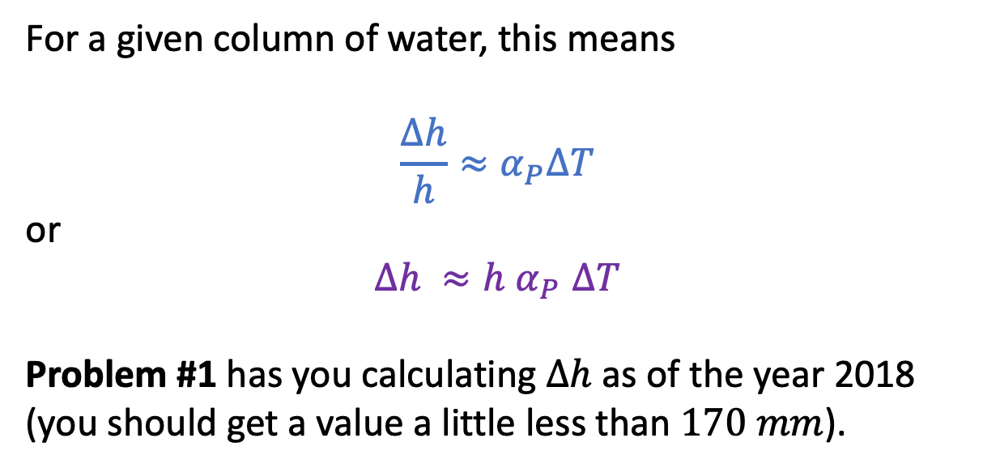
Problem #1 in GeophysicalApplications: Predicting sea level rise due to thermal expansion
$$α_{P}≡\frac{1}{V}{\left(\frac{∂V}{∂T}\right)}_{P}$$
For a given column of water, this means
$${\frac{∆h}{h}≈α}_{P}∆T$$
or
$$∆h {≈h α}_{P}∆T$$
Problem #1 has you calculating $∆h$ as of the year 2018 (you should get a value a little less than $170 mm$).
$$∆h$$
$$h$$

Slide 8
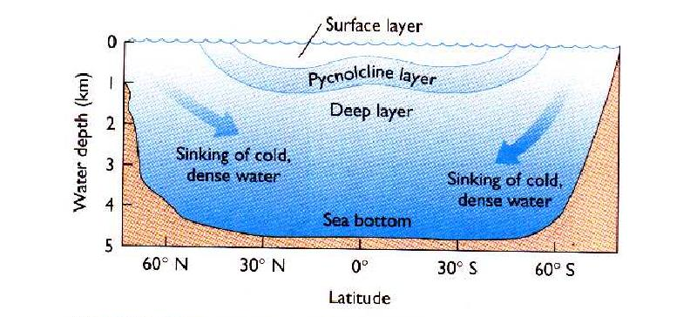
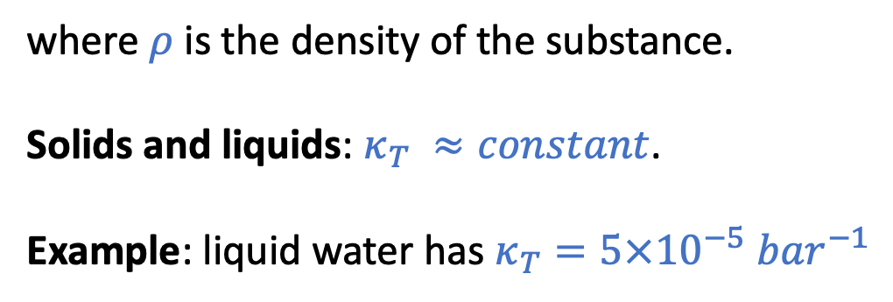
Next: the isothermal compressibility (of water)
$κ_{T}≡−\frac{1}{V}{\left(\frac{∂V}{∂P}\right)}_{T}$ … for small changes in pressure, we can say $\frac{∆V}{V}=−\frac{∆ρ}{ρ}≈{−κ}_{T}∆P$
where $ρ$ is the density of the substance.
Solids and liquids: $κ_{T} ≈constant$.
Example: liquid water has $κ_{T}=5×10^{−5}{ bar}^{−1}$
http://www.ccpo.odu.edu/~atkinson/OCN306/lec42/img019.jpg

Slide 9
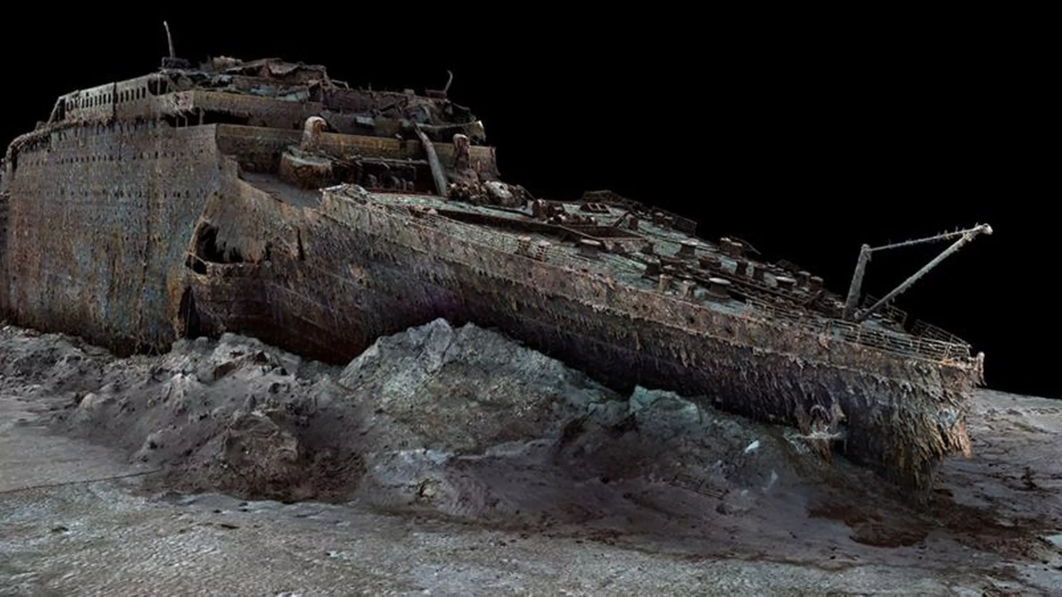
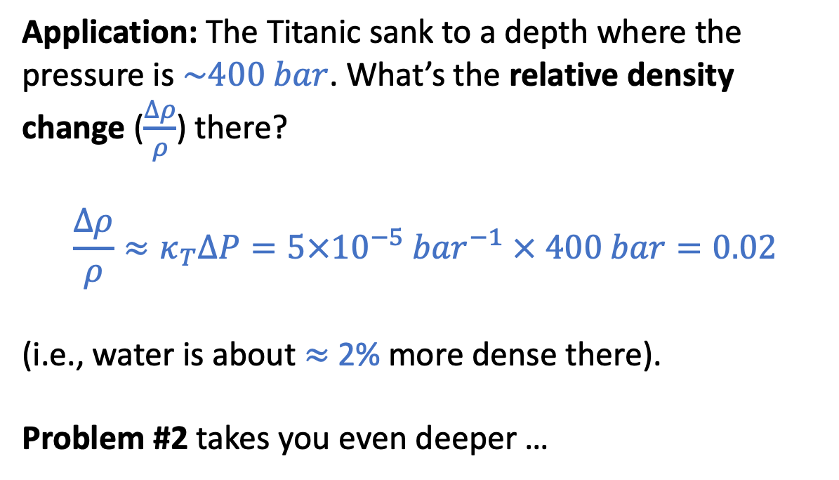
Problem #2 in GeophysicalApplications: the isothermal compressibility (of water)
$κ_{T}≡−\frac{1}{V}{\left(\frac{∂V}{∂P}\right)}_{T}$ … for small changes in pressure, we can say $\frac{∆V}{V}=−\frac{∆ρ}{ρ}≈{−κ}_{T}∆P$
Application: The Titanic sank to a depth where the pressure is $\sim 400 bar$. What’s the relative density change ($\frac{∆ρ}{ρ}$) there?
$$\frac{∆ρ}{ρ}≈κ_{T}∆P=5×10^{−5}{ bar}^{−1} × 400 bar=0.02$$
(i.e., water is about $≈$ 2% more dense there).
Problem #2 takes you even deeper …
2.4 miles (13,000 feet)

Slide 10
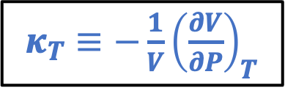
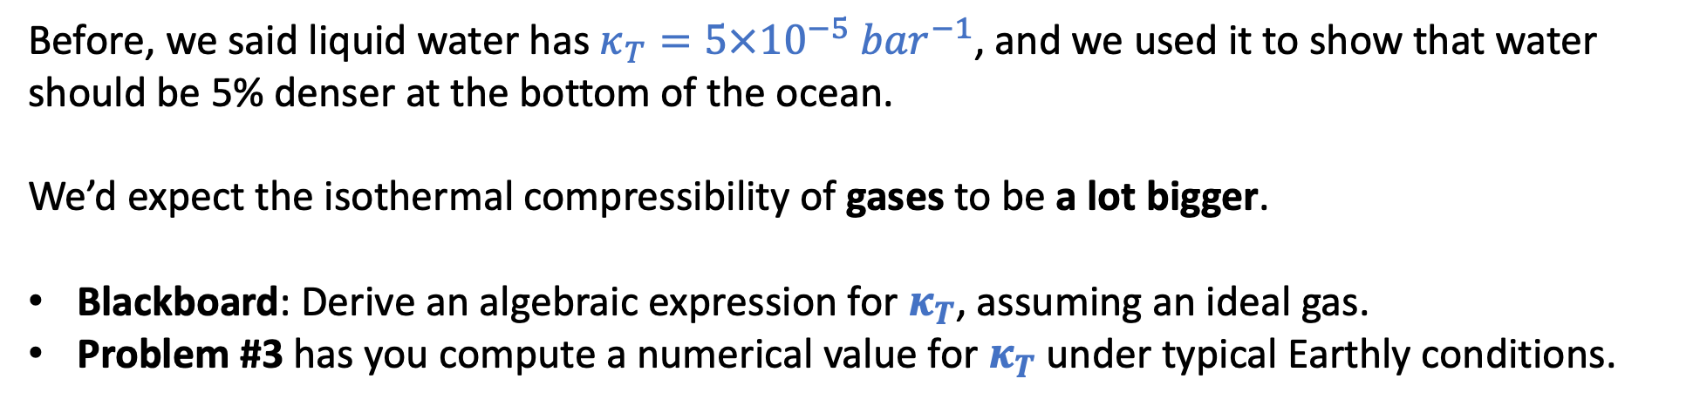
Problem #3 in GeophysicalApplications: the isothermal compressibility of an ideal gas
$κ_{T}≡−\frac{1}{V}{\left(\frac{∂V}{∂P}\right)}_{T}$
Before, we said liquid water has $κ_{T}=5×10^{−5}{ bar}^{−1}$, and we used it to show that water should be 5% denser at the bottom of the ocean.
We’d expect the isothermal compressibility of gases to be a lot bigger.
Blackboard: Derive an algebraic expression for $κ_{T}$, assuming an ideal gas.
Problem #3 has you compute a numerical value for $κ_{T}$ under typical Earthly conditions.

Slide 11
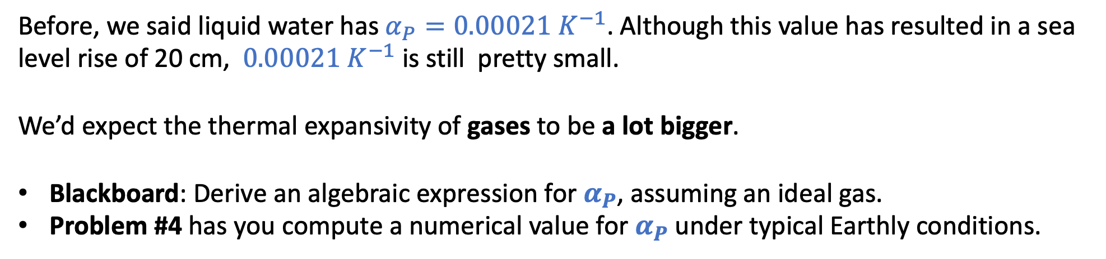
Problem #4 in GeophysicalApplications: the isobaric thermal expansivity of an ideal gas
$α_{P}≡\frac{1}{V}{\left(\frac{∂V}{∂T}\right)}_{P}$ … for small changes in temperature, we can say $\frac{∆V}{V}≈α_{P}∆T$
Before, we said liquid water has $α_{P}=0.00021{ K}^{−1}$. Although this value has resulted in a sea level rise of 20 cm, $0.00021{ K}^{−1}$ is still pretty small.
We’d expect the thermal expansivity of gases to be a lot bigger.
Blackboard: Derive an algebraic expression for $α_{P}$, assuming an ideal gas.
Problem #4 has you compute a numerical value for $α_{P}$ under typical Earthly conditions.

Slide 12
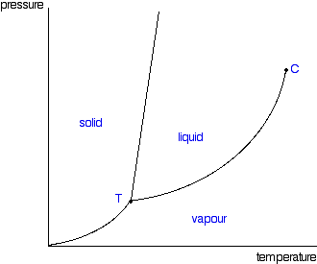

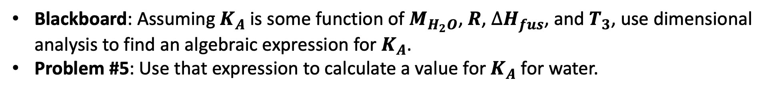


Problem #5 in GeophysicalApplications: $K_{A}$ of Blagdon’s Law
P
Blagden says $∆T_{F}=K_{A}b_{B} i_{B}$
$∆T_{F}$
T
$$b_{B}$$
Blackboard: Assuming $K_{A}$ is some function of $M_{H_{2}O}$, $R$, $∆H_{fus}$, and $T_{3}$, use dimensional analysis to find an algebraic expression for $K_{A}$.
Problem #5: Use that expression to calculate a value for $K_{A}$ for water.

Slide 13

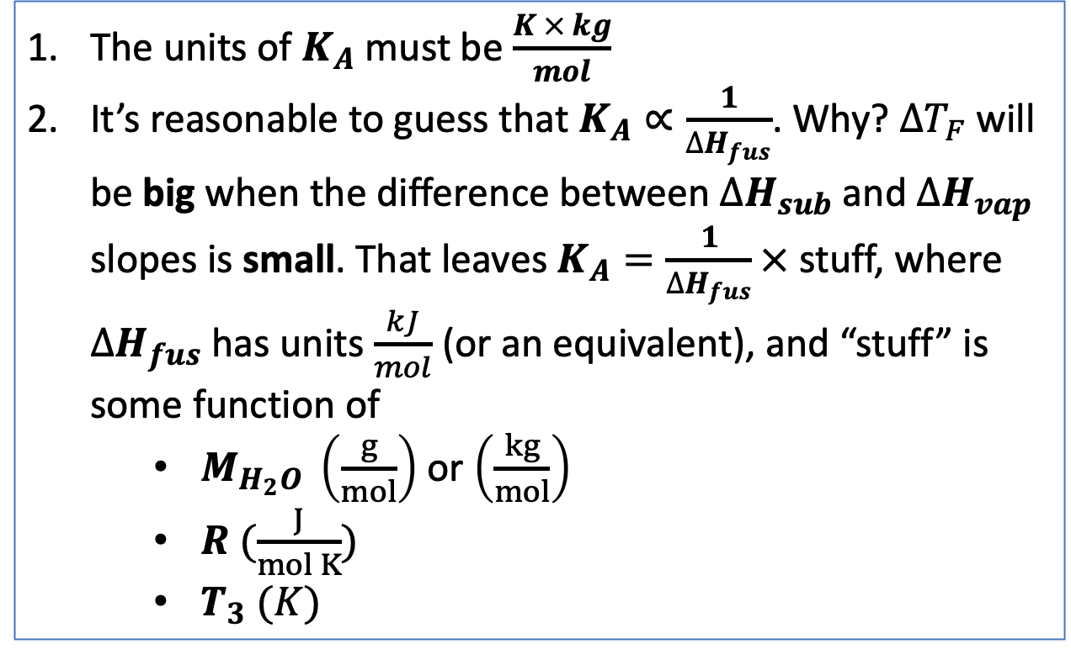


Some notes on the blackboard work on deriving $K_{A}$
The units of $K_{A}$must be $\frac{K × kg}{mol}$
It’s reasonable to guess that $K_{A}∝\frac{1}{∆H_{fus}}$. Why? $∆T_{F}$ will be big when the difference between $∆H_{sub}$ and $∆H_{vap}$ slopes is small. That leaves $K_{A}=\frac{1}{∆H_{fus}}×$ stuff, where $∆H_{fus}$ has units $\frac{kJ}{mol}$ (or an equivalent), and “stuff” is some function of
$M_{H_{2}O} \left(\frac{g}{mol}\right)$ or $\left(\frac{kg}{mol}\right)$
$R (\frac{J}{mol K})$
$T_{3} (K)$
Blagden: $∆T_{F}≈K_{A}× b_{B} × i_{B}$
$∆T_{F}$
$$b_{B}$$

Slide 14
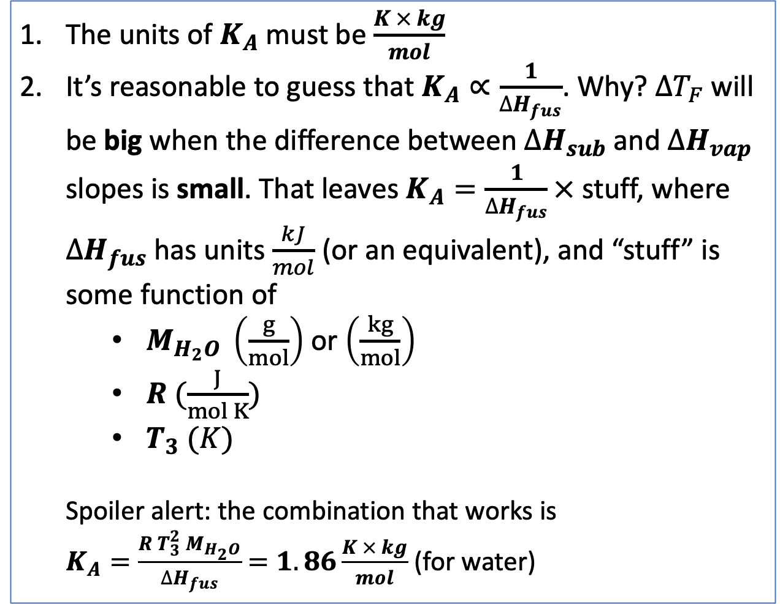
Some notes on the blackboard work on deriving $K_{A}$
The units of $K_{A}$must be $\frac{K × kg}{mol}$
It’s reasonable to guess that $K_{A}∝\frac{1}{∆H_{fus}}$. Why? $∆T_{F}$ will be big when the difference between $∆H_{sub}$ and $∆H_{vap}$ slopes is small. That leaves $K_{A}=\frac{1}{∆H_{fus}}×$ stuff, where $∆H_{fus}$ has units $\frac{kJ}{mol}$ (or an equivalent), and “stuff” is some function of
$M_{H_{2}O} \left(\frac{g}{mol}\right)$ or $\left(\frac{kg}{mol}\right)$
$R (\frac{J}{mol K})$
$T_{3} (K)$
Spoiler alert: the combination that works is
$K_{A}=\frac{{R T}_{3}^{2} M_{H_{2}O}}{∆H_{fus}}$ $=1.86\frac{K × kg}{mol}$ (for water)
Blagden: $∆T_{F}≈K_{A}× b_{B} × i_{B}$
$∆T_{F}$
$$b_{B}$$

Slide 15
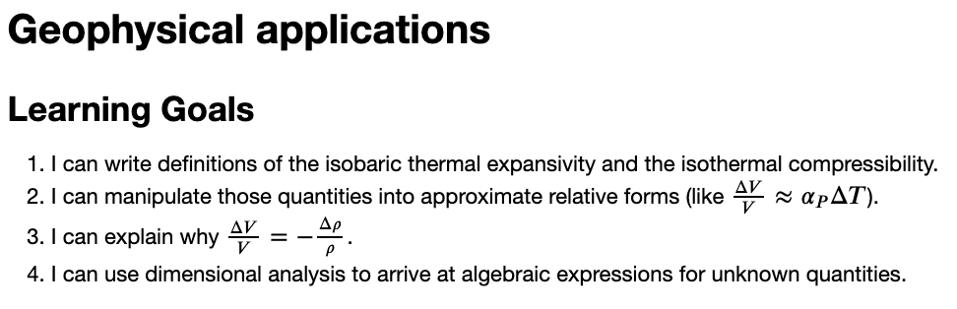
OK, let’s get started

